Slide 1

Monitor water
The Smart Plant Monitoring Kit​​

Slide 2
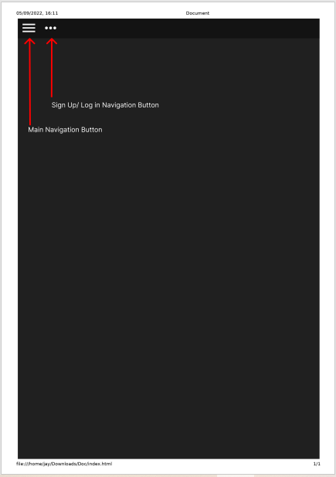
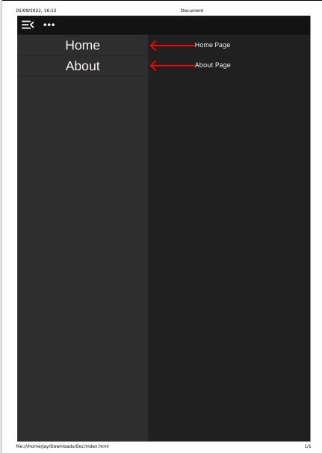
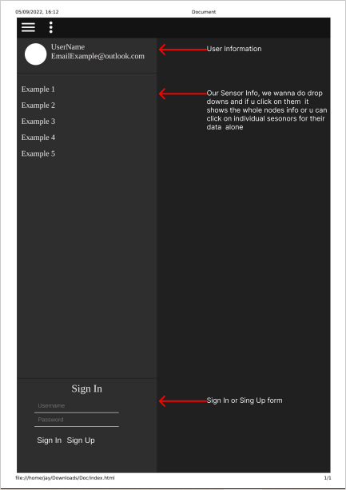
Table of Contents
Sign up/log in
HOME PAGE
Authentic
Previous Page

Slide 3
Sign Up/Log in navigation button
-THIS BUTTON WILL LEAD YOU TO WHERE YOU CAN EITHER REGISTER OR LOG IN IF YOU HAVE ALREADY SIGNED UP.
Main navigation button
- THIS BUTTON PROVIDES EASY NAVIGATIONWITHIN THE WEBSITE TO HELP THE USER BROWSE THROUGH THE WEBSITE EFFORTLESSLY
Previous Page
Pitch deck

Slide 4
-This button will lead to a page containing general information about our organization, the mission and the purpose of our website
HOME PAGE
-THIS BUTTON WILL LEAD TO THE DEFAULT OR FRONT PAGE OF THE WEBSITE. IT IS THE FIRST PAGE THAT THE USER WILL SEE WHEN THEY OPEN THE WEBSITE.
ABOUT PAGE
Previous Page
Pitch deck

Slide 5
Business model
USER NFORMATION
THIS IS WHERE INFORMATION OR OTHER CONTENT ENTERES BY THE USER/ ANY OTHER USER WHO HAS LOGGED IN WHILE ACCESSING THE SERVICES
Sensor information
-WE WANNA DO DROP DOWNS AND IF YOU CLICK ON THEM, IT WILL SHOW THE WHOLE NODES INFORMATION OR YOU CAN CLUICK ON INDIVIDUAL SENSORS FOR THEIR DATA ALONE
Previous Page
Pitch deck

Slide 6
Sign in or sign up form
-Sign in means you are already registered, and your credentials are already saved with the account, and you are just authenticating yourself as a returning user.
Sign up taken by the users who identifies as a new users.
Previous Page
Pitch deck

Slide 7
The End!!!
20XX
Pitch deck

